Slide 1



Project windows 10
Shalev zaken

Slide 2
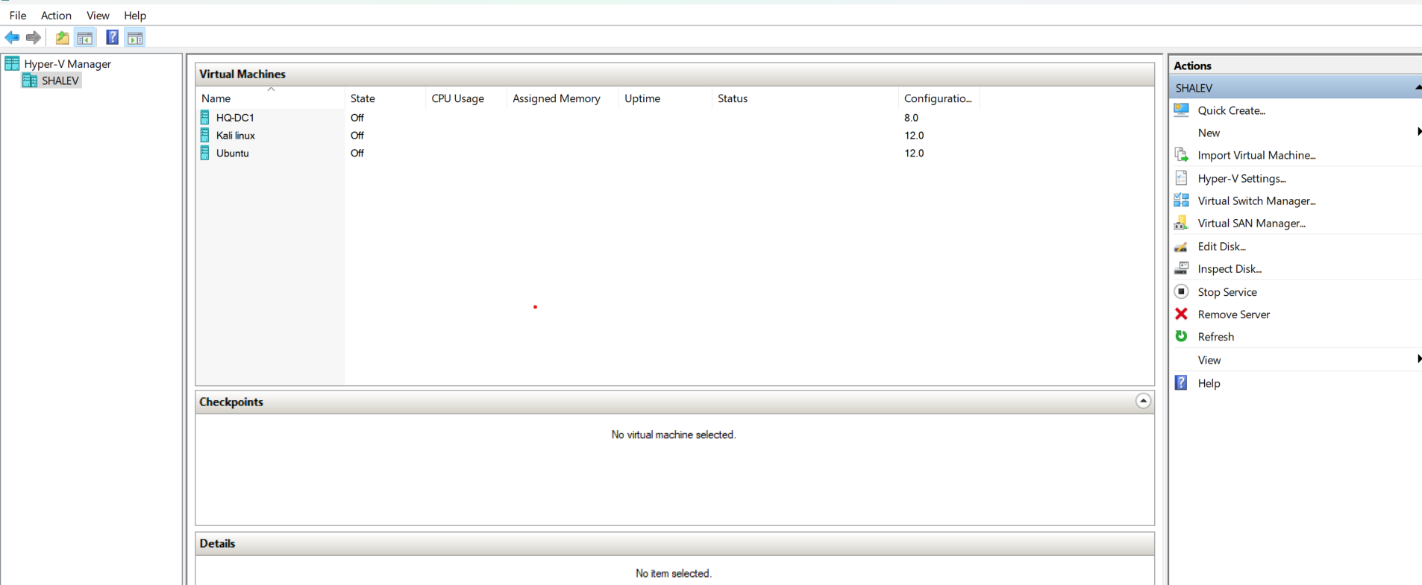




1. Delete all the Machines without DC
( I leave kali Linux and ubuntu for myself)

Slide 3
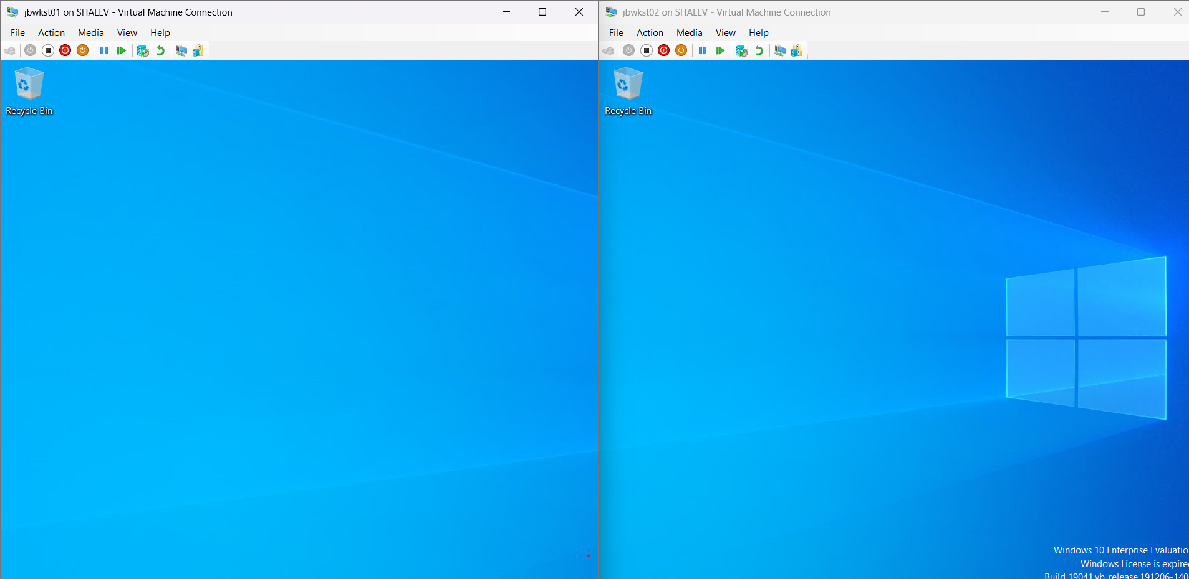
2-4. JBWKST01 and JBWKST02 {create 2 windows 10 machines }

Slide 4
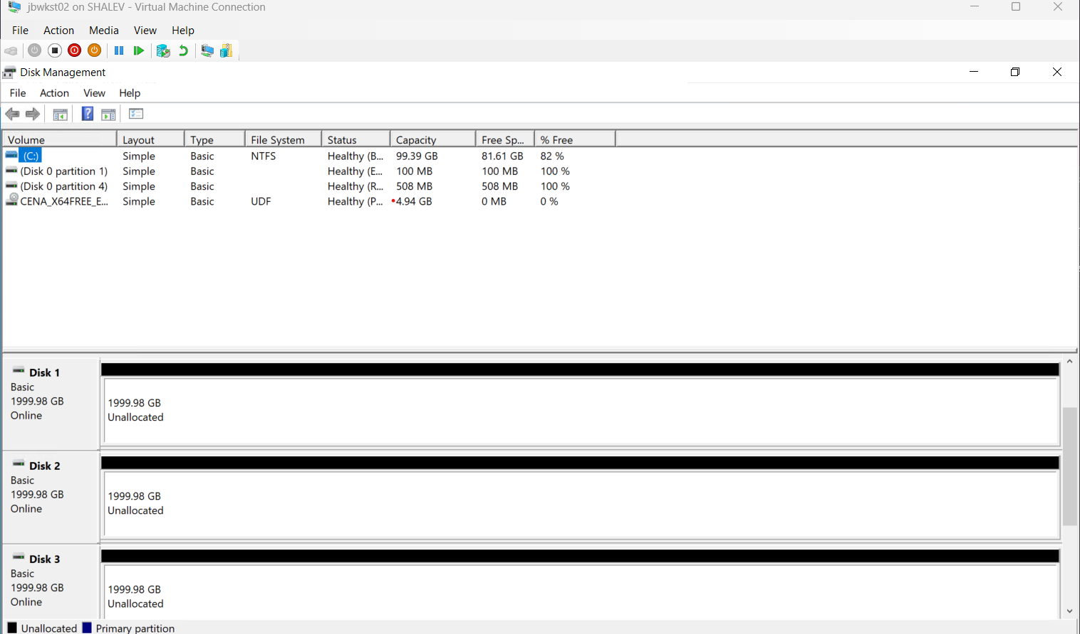
5. JBWKST02 Disk management (Disk 1,2,3)

Slide 5
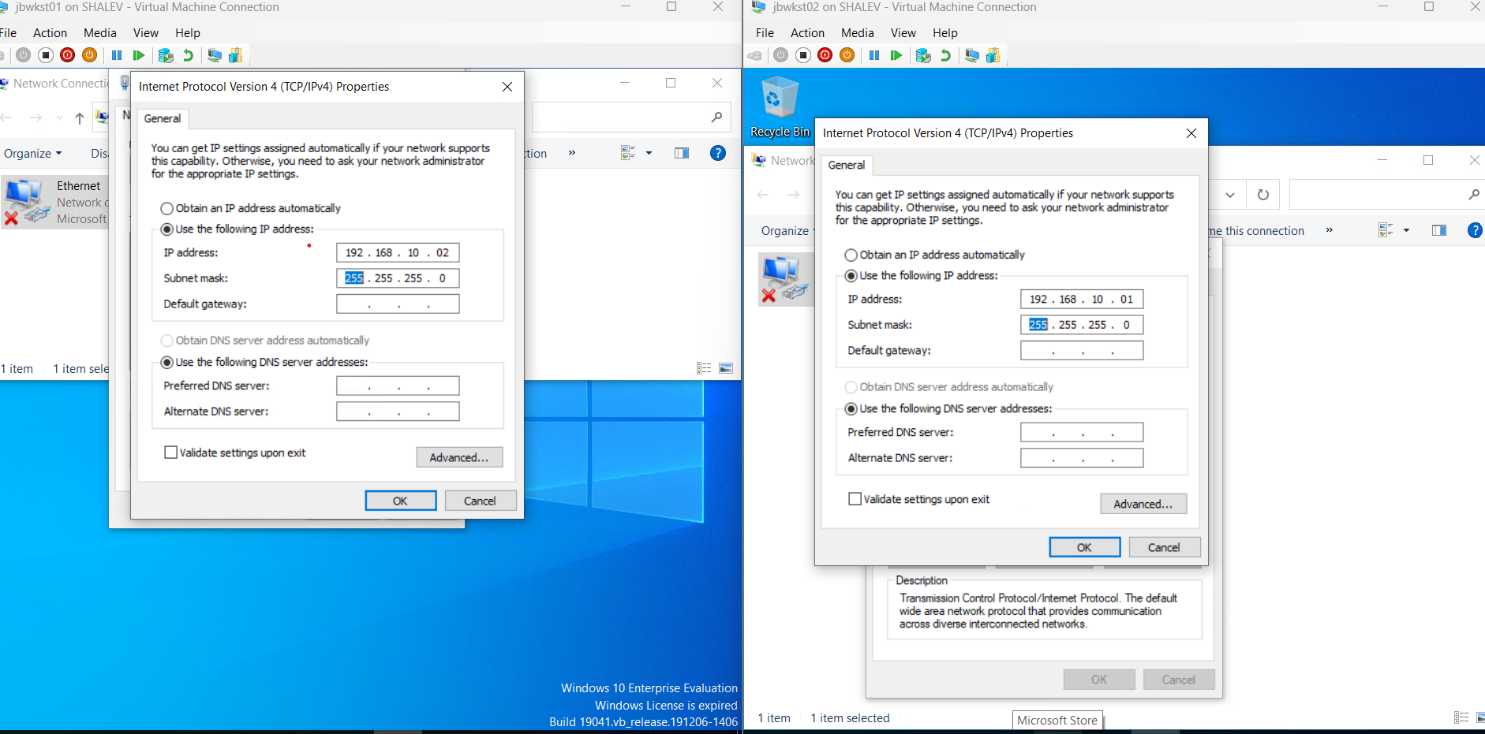
6. Adress (JBWKST01 and JBWKST02)

Slide 6
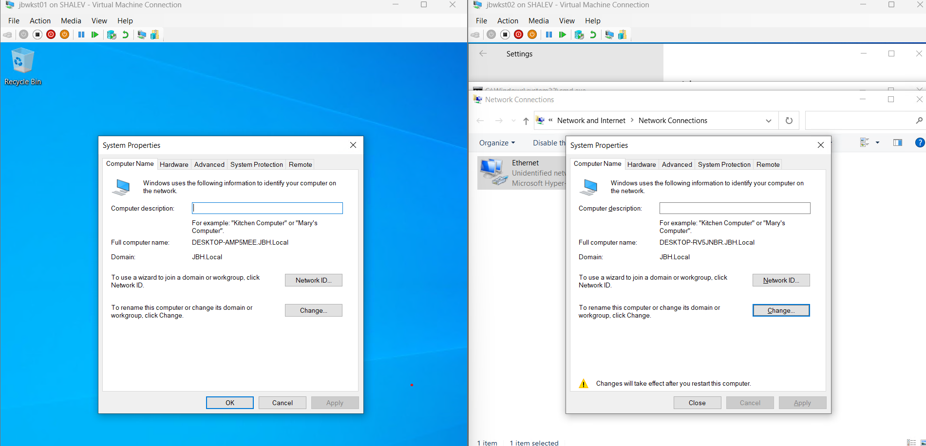
7. JBWKST01 and JBWKST02 connected to the Domain

Slide 7
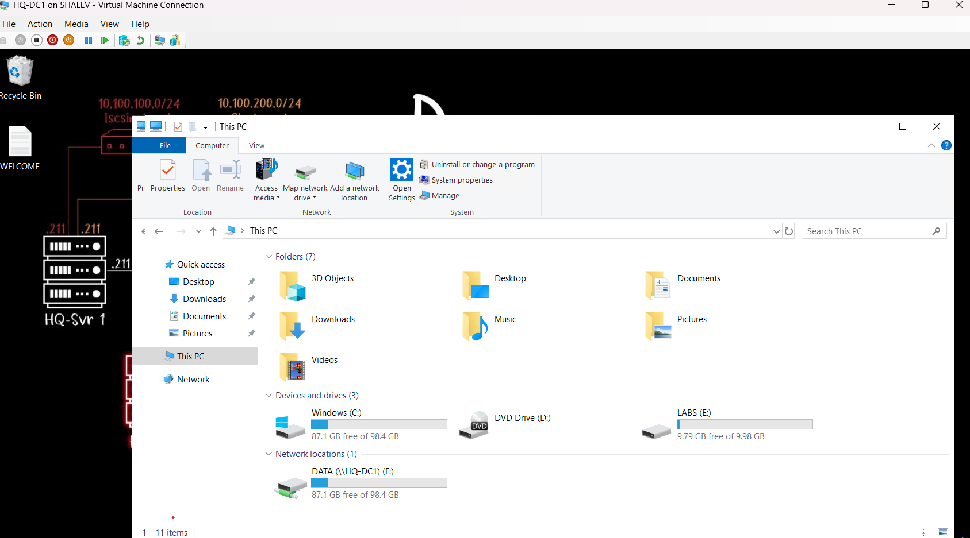
8. Shared Network folder “DATA” created in HQ-DC1

Slide 8
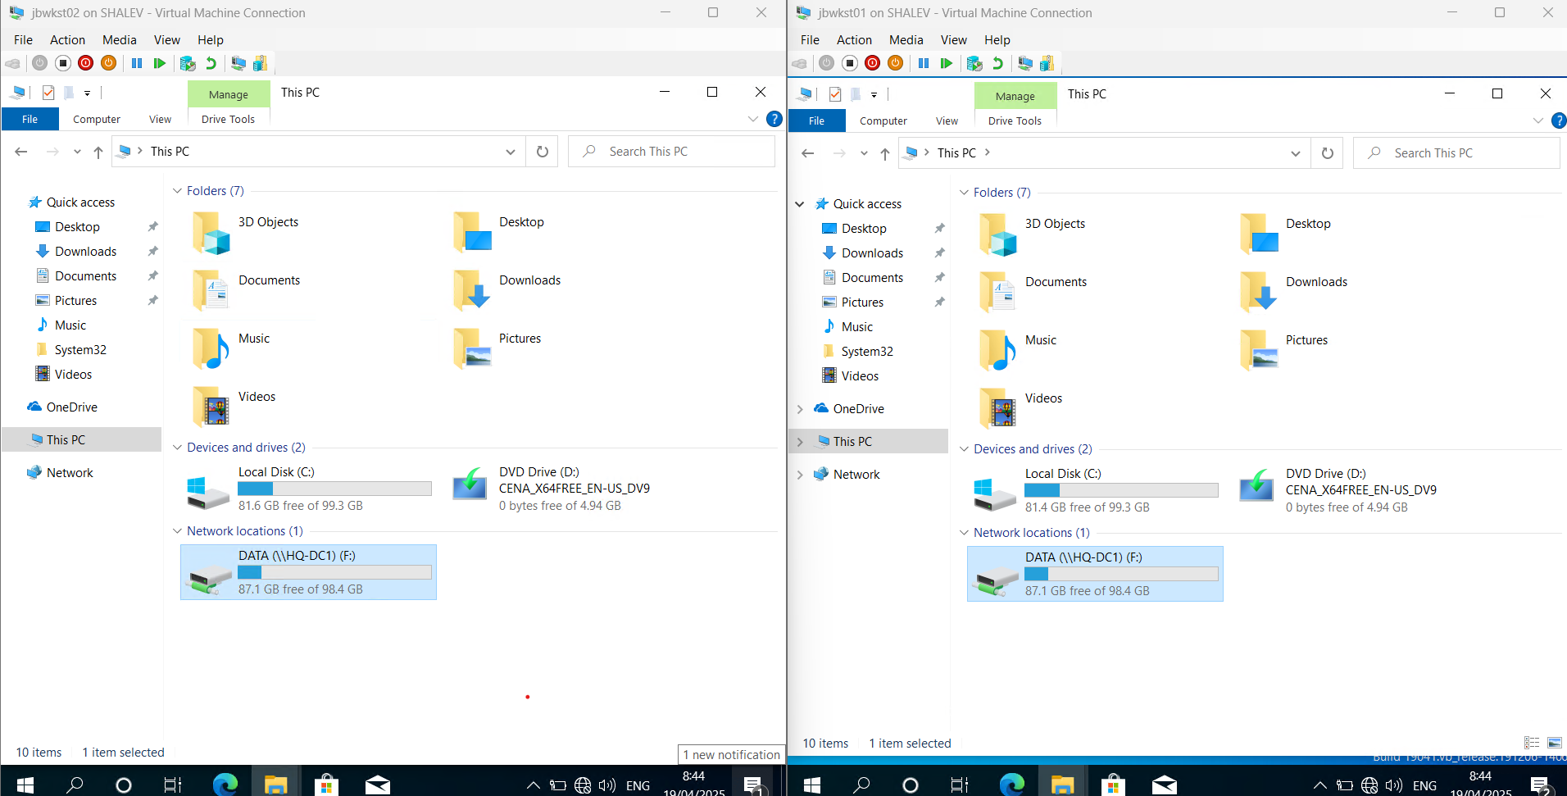
9. Network drive (F)

Slide 9
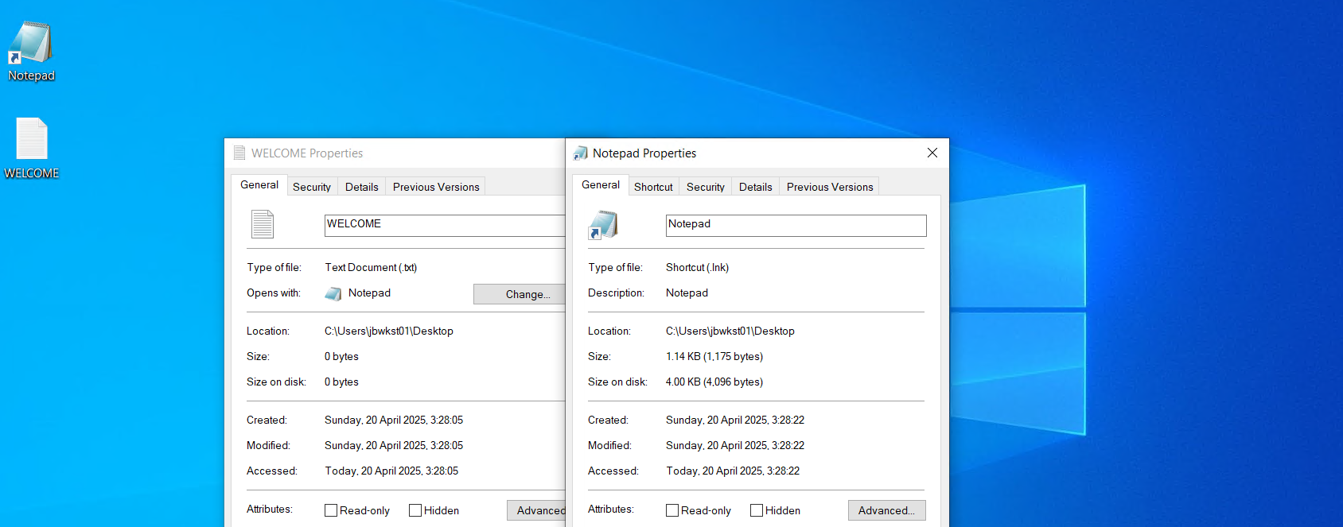
10. Notepad shortcut and text in desktop with new user

Slide 10
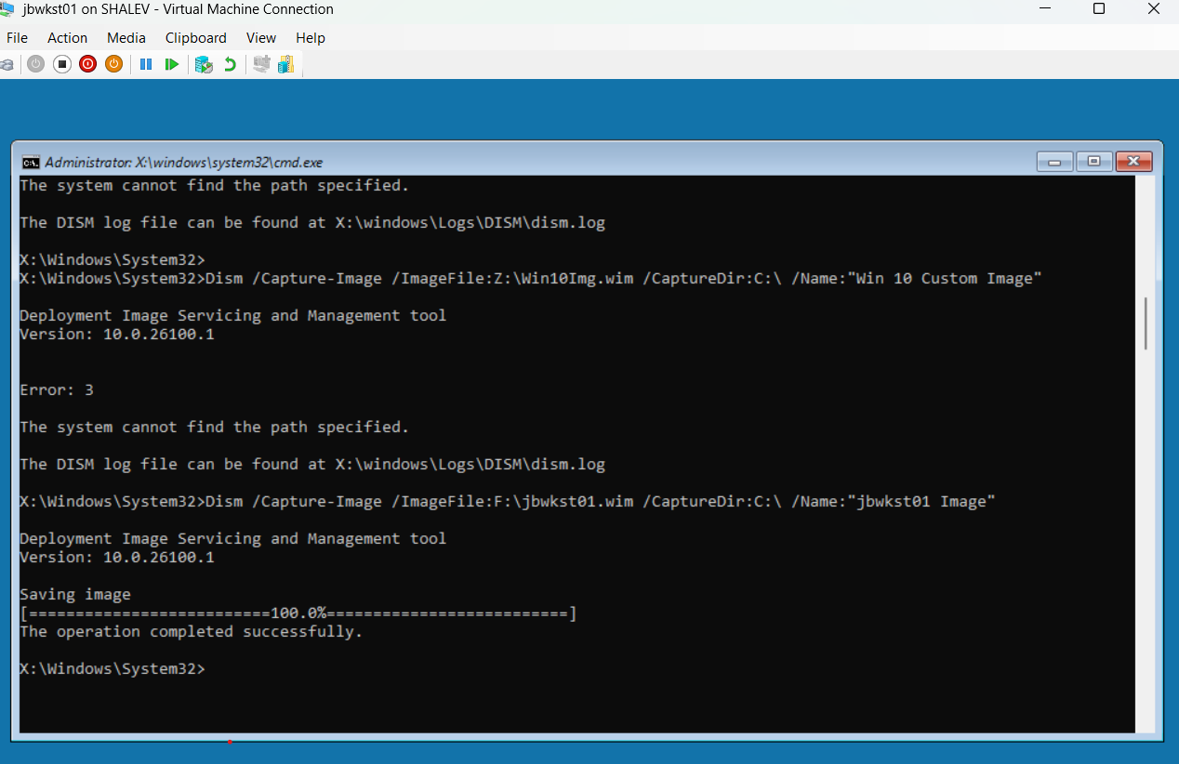
11. Capture image and save to the Network

Slide 11
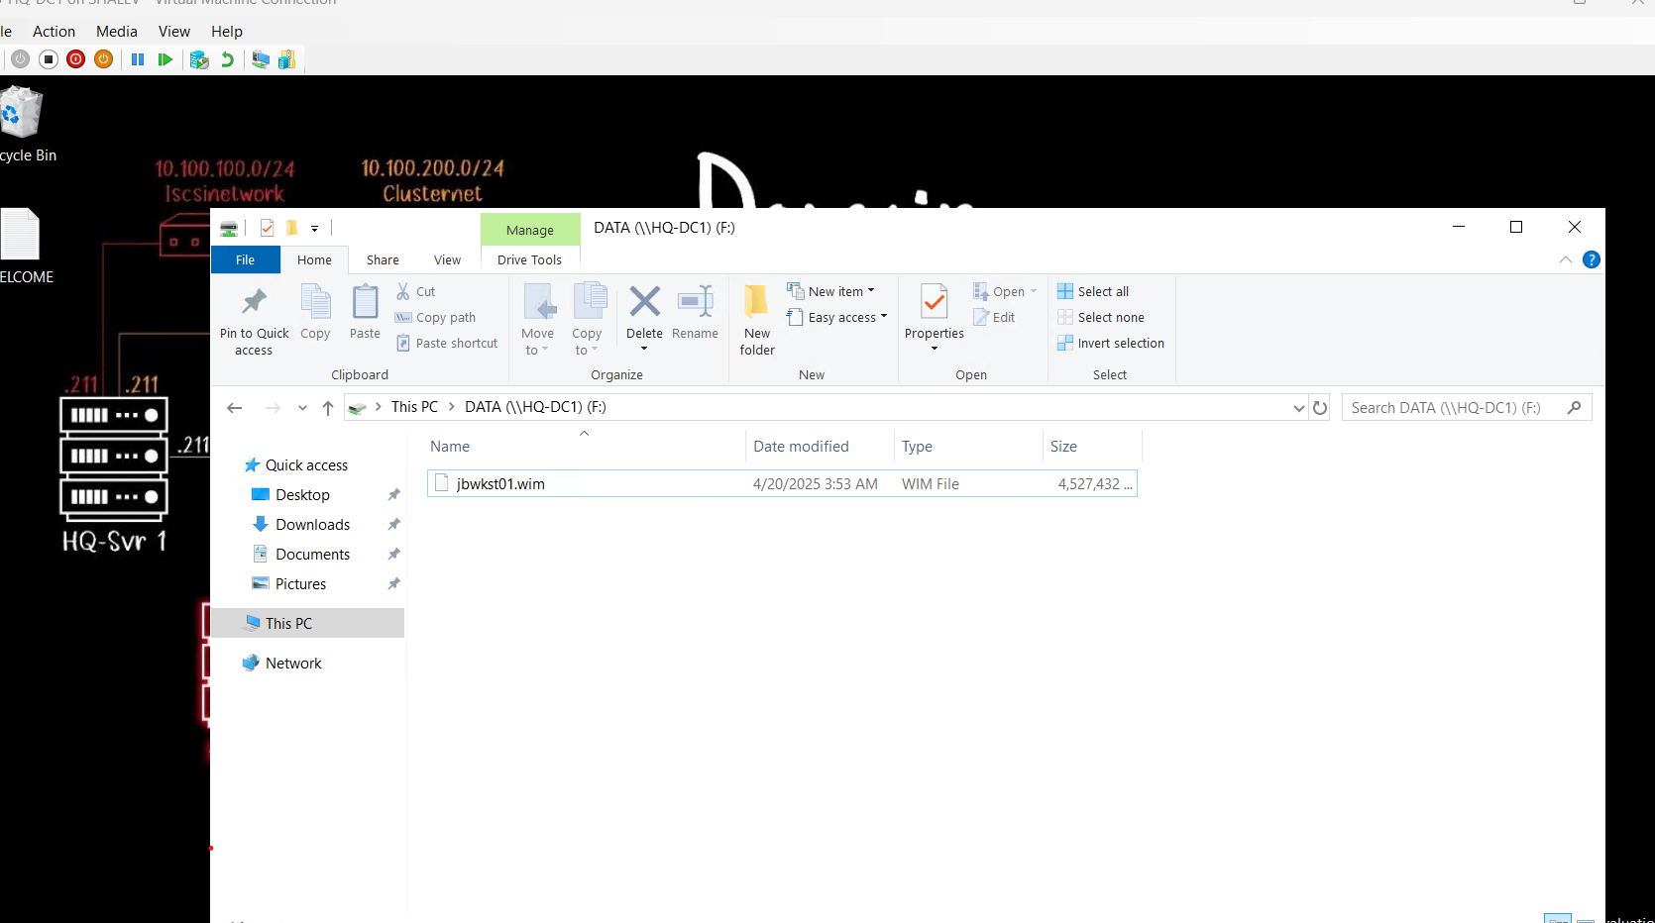
11.Image file located in the Network Drive

Slide 12
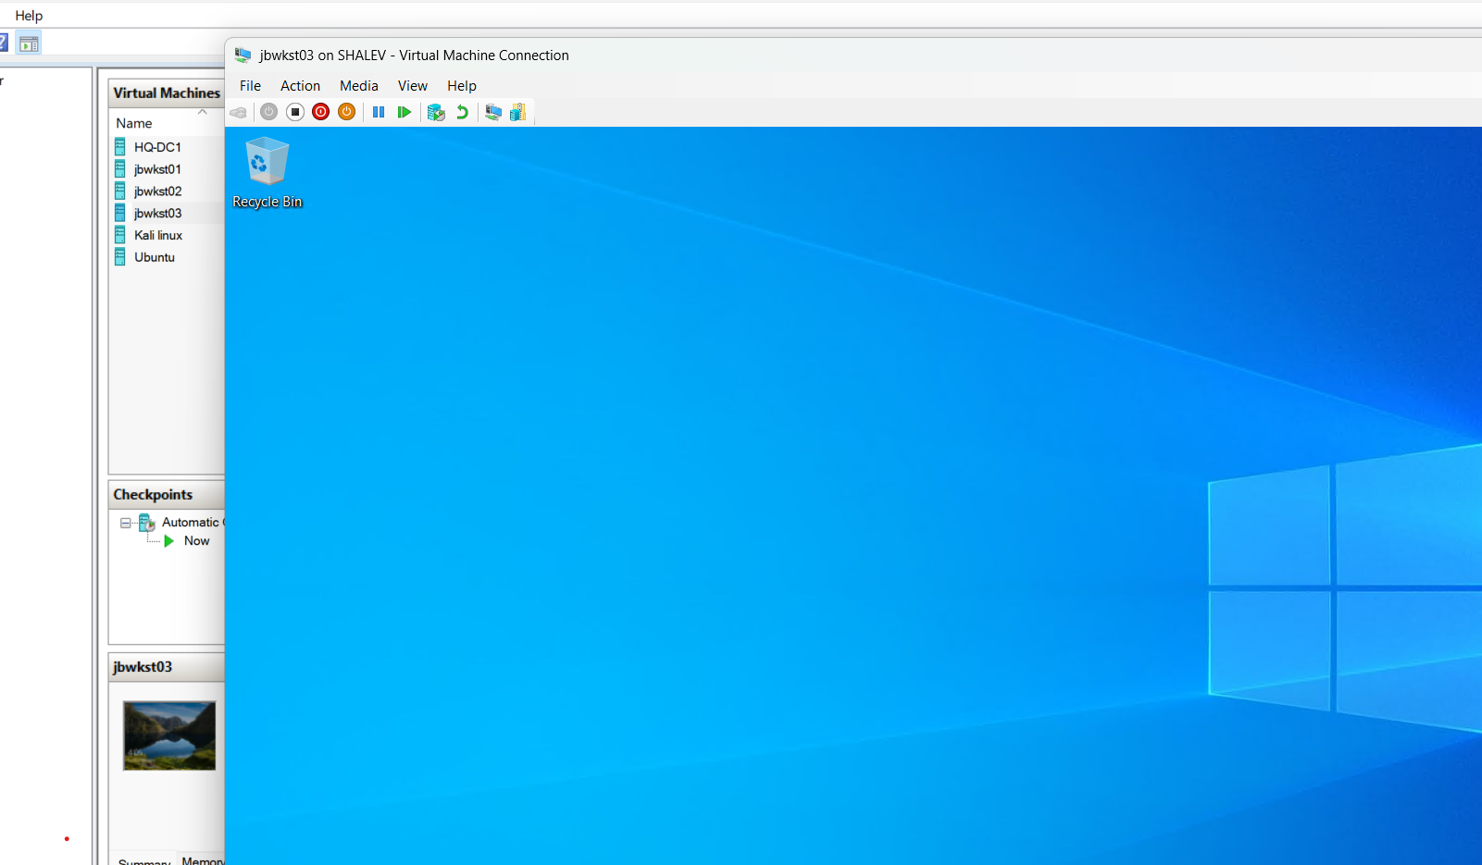
12. Create new machine “jbwkst03”

Slide 13
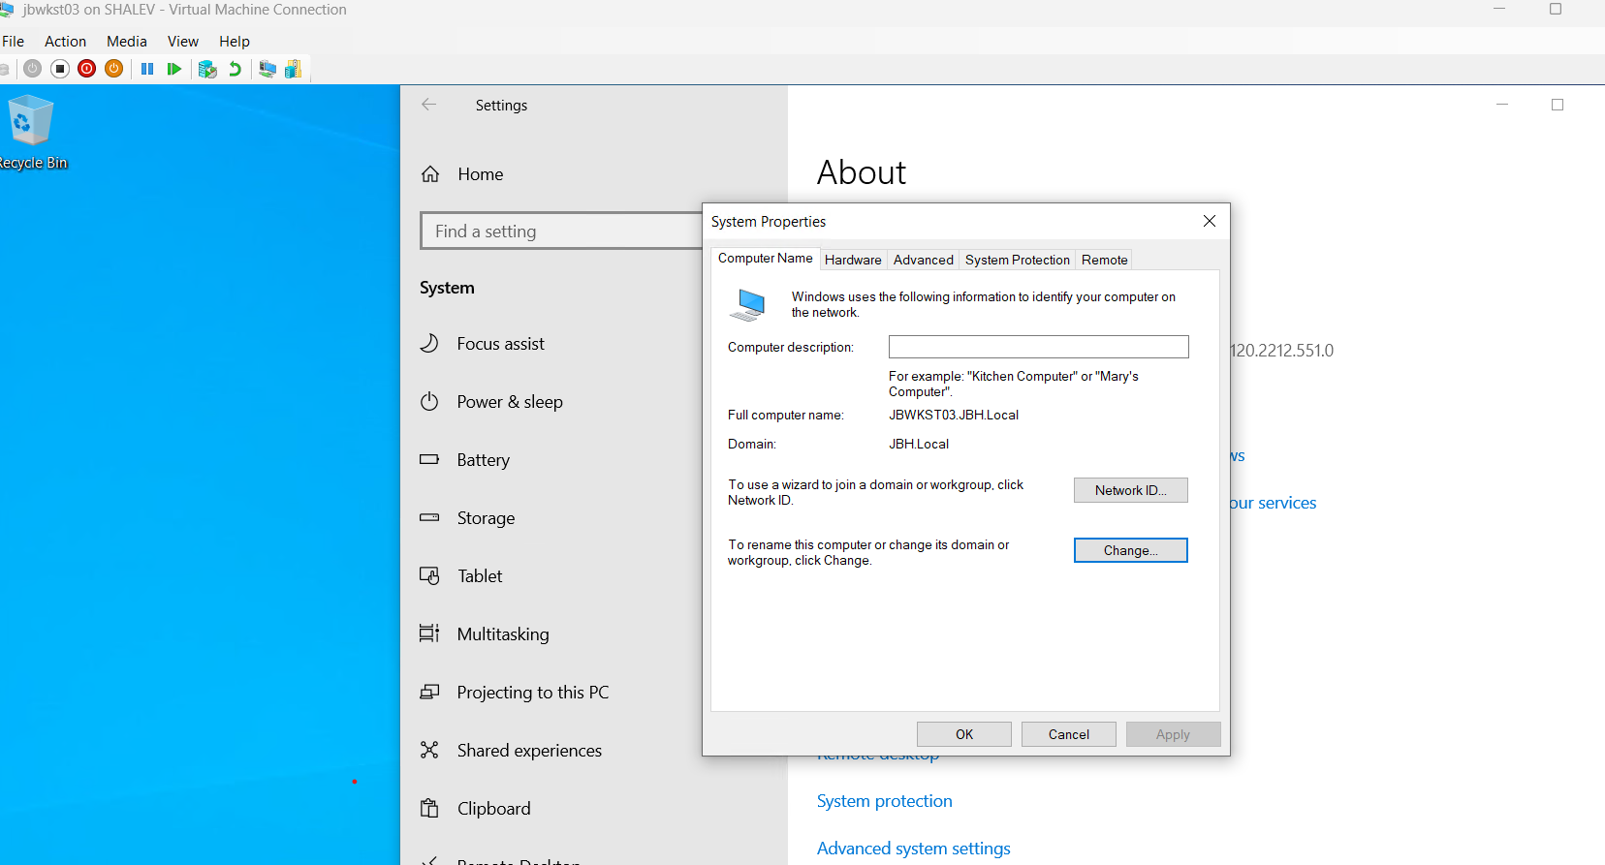
13-14. Connect the Machine to the domain

Slide 14
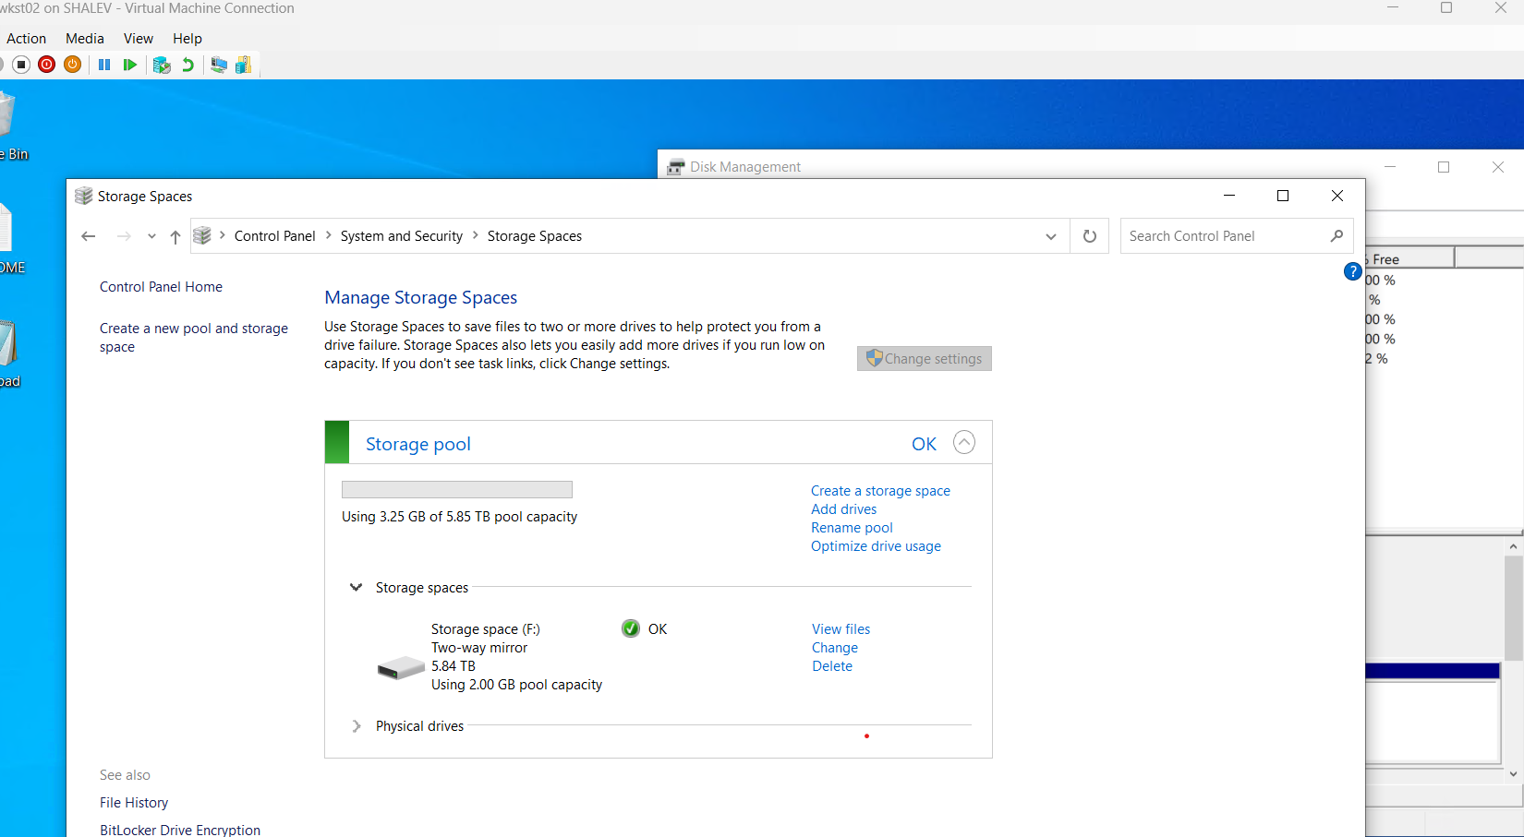
15. Disk1,2,3 storage information

Slide 15
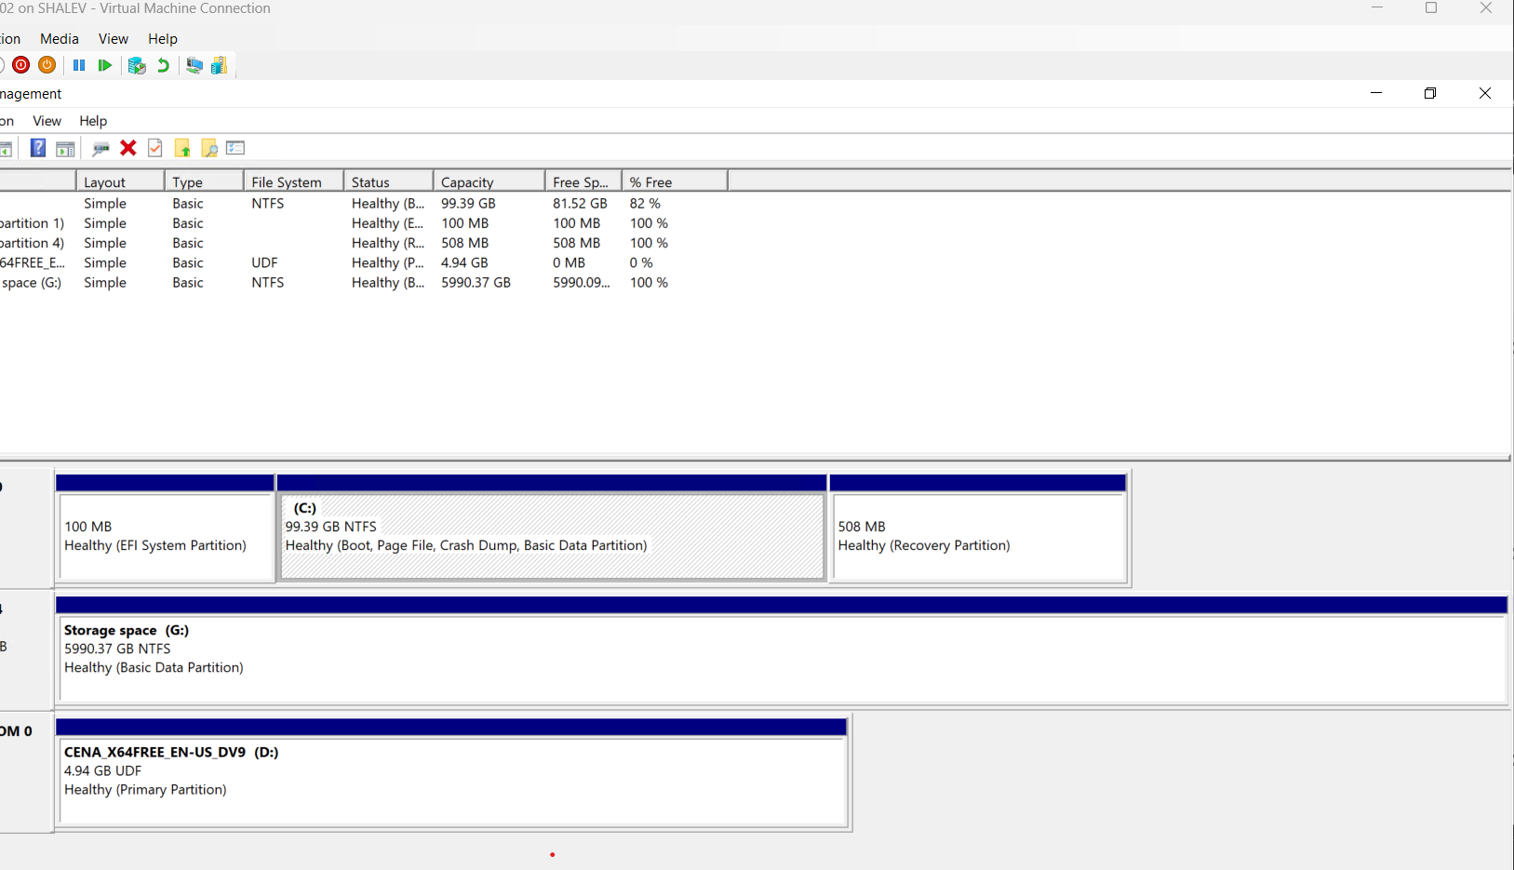
15. Disk Management

Slide 16
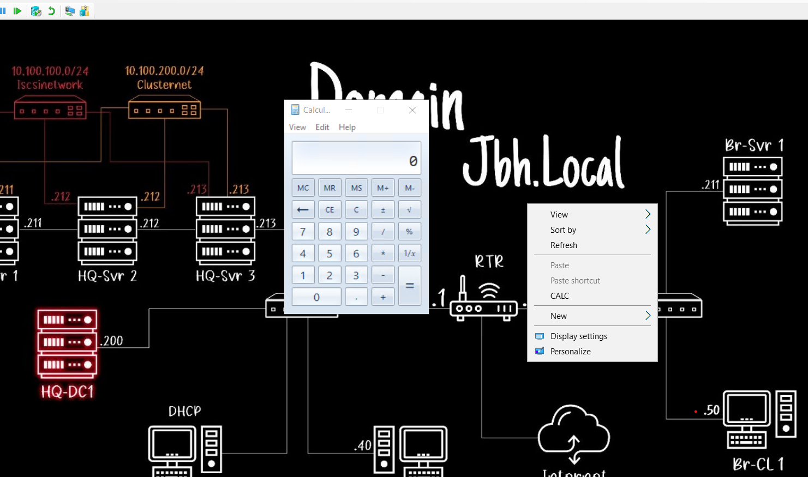
16. CALC by registry

Slide 17
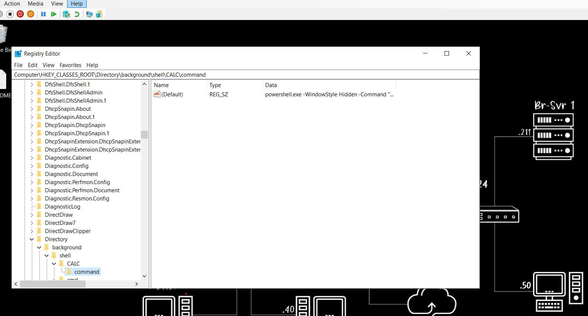
16. Regedit interface

Slide 18
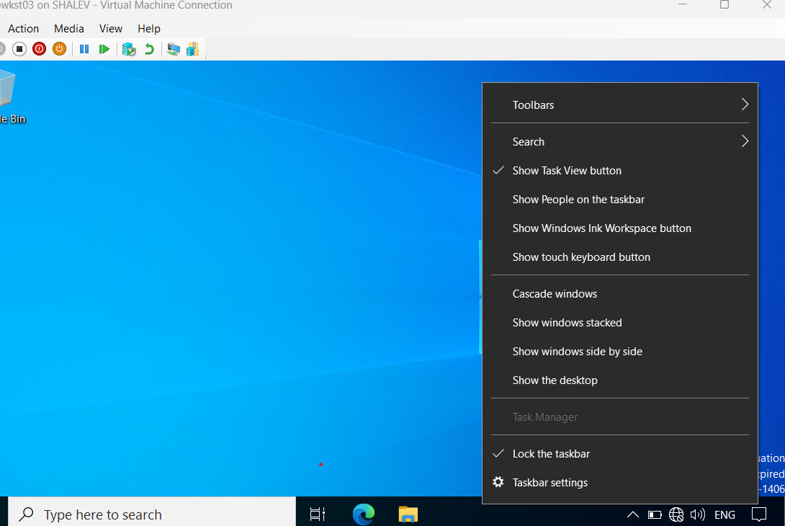
17. Account “TEST” without Clock and task manager

Slide 19
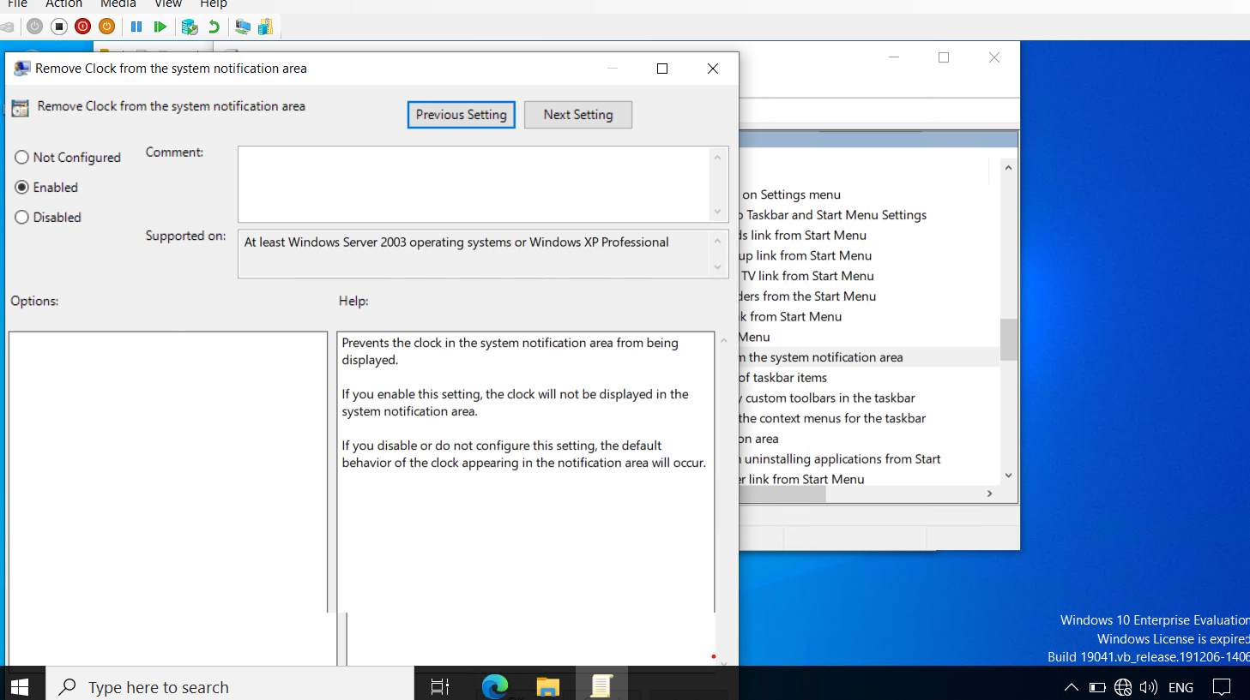
17. GPEDIT – Remove Clock

Slide 20
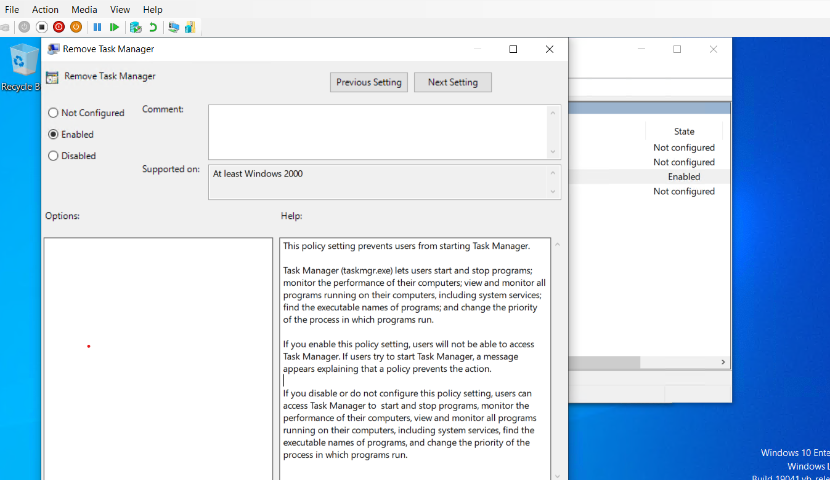
17.GPEDIT- Remove Task Manager

Slide 21
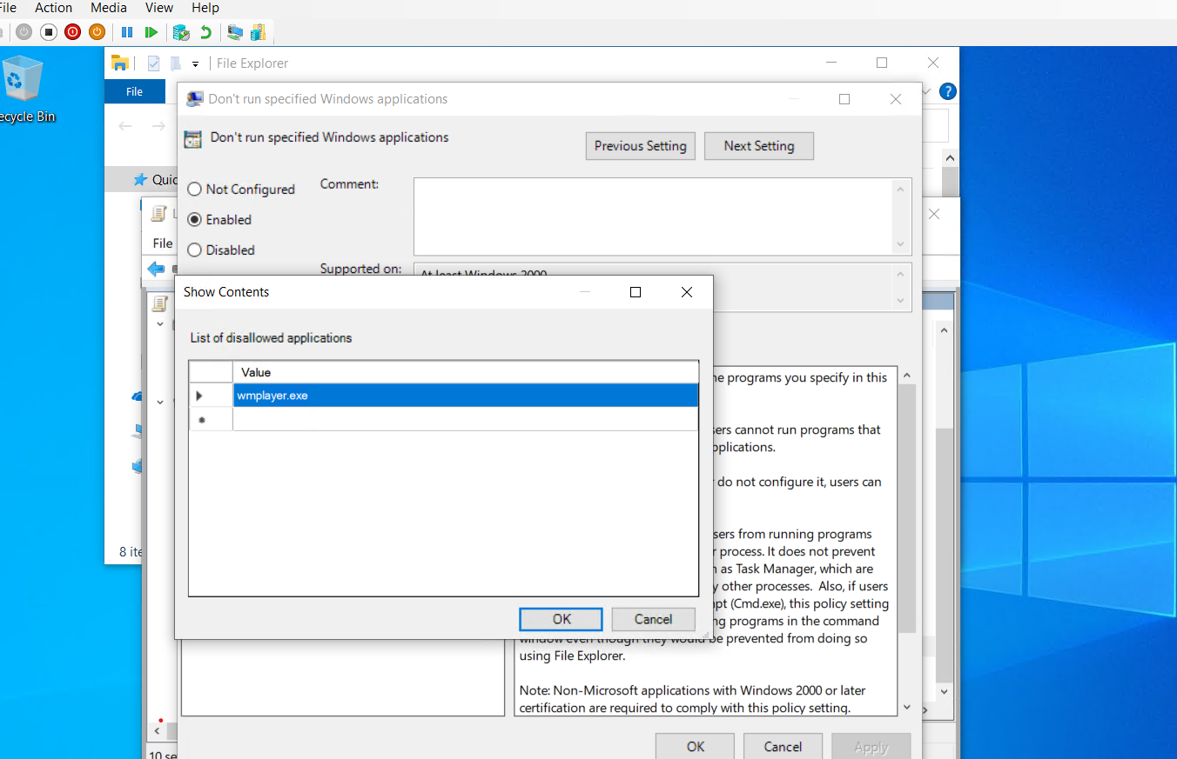
18. GPEDIT- Remove Media Player

Slide 22
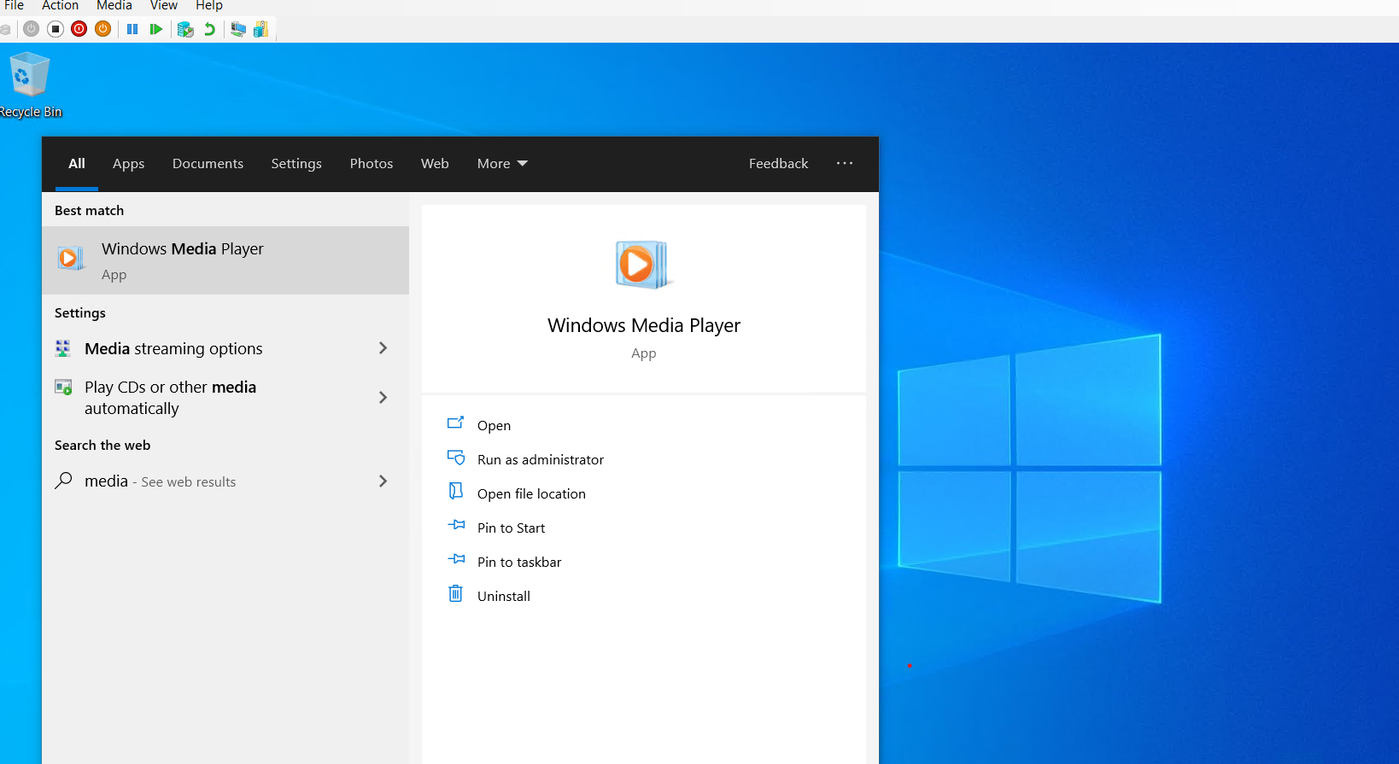
18. Media Player- The application can’t open

Slide 23

Finish

